Slide 1

Intro to KnockoutJS
Forward Thinking

Slide 2
About
Steve Duitsman
@SteveDuitsman
https://github.com/SteveDuitsman/MVVM_Examples
steve.duitsman@centare.com

Slide 3
KnockoutJS
Client-Side MVVM JavaScript Library
40kb (minified), 166kb (debug)
No dependencies
Works on all mainstream browsers
IE6+, FF2+, Chrome, Safari, Opera
Developed with BDD
NuGet or knockoutjs.com

Slide 4
MVVM Pattern
MODEL
VIEW MODEL
VIEW

Slide 5

Knockout Features
Declarative Bindings
Dependency Tracking
Automatic UI Refresh
Templating

Slide 6
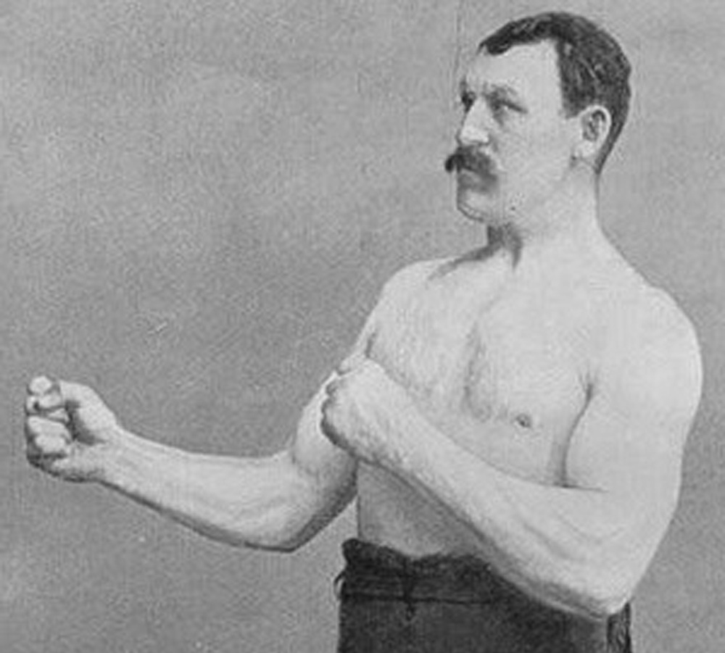
Demo

Slide 7
Basics
jQuery Example
data-bind attributes
ko.observable()
ko.applyBindings()
Debug Text

Slide 8
Basics
var self = this;
ko.computed()
Dependency Tracking
visible binding

Slide 9
Custom Bindings
ko.bindingHandlers
init and update events
element
valueAccessor
allBindings
viewModel
bindingContext

Slide 10
Advanced
ko.observableArray
ko.mapping
ko.utils
Control Flow Bindings
foreach
if
with
Containerless Syntax

Slide 11
Advanced
Binding Contexts
$root
$parent
$parents
$parents[0] == $parent
$parent[1] … $parent[n]
$data

Slide 12
Templates & Saving Data
Templates in Knockout
ko.toJSON

Slide 13

Why Knockout?

Slide 14
Why Knockout
High level link between UI & data model
Extensible
Usable in existing apps/architecture
Learning Resources
Same MV* pattern & benefits as other solutions
It boils down to:
Scope & Feel

Slide 15
Resources
knockoutjs.com
Live Examples/Tutorials
Documentation
Knock Me Out - Ryan Niemeyer’s blog
PluralSight Courses
Knockout Fundamentals
HTML5 and JS Apps With MVVM and Knockout
SPAs with HTML5, WebAPI, Knockout and jQuery

Slide 16
Questions

